Slide 1
La Conner Marina Master Plan Update November/December 2015
History
Vision
Master Plan
Slide 2-4
Slide 5-6
Slide 7-12

Slide 2
1966 Project Rendering
The Port’s first economic development plan called for a boat harbor in La Conner.
The facilities envisioned included:
Loading/unloading facilities for barge traffic
Warehouses
Up to 250 slips for commercial fishing
Up to 350 slips for pleasure boats.

Slide 3
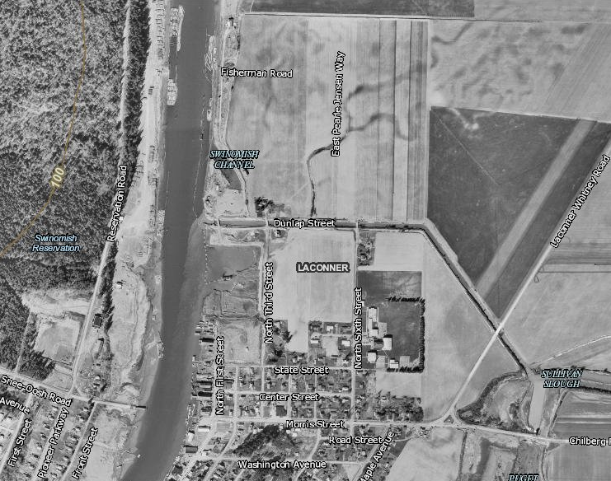
1969 Aerial Photo
Pictured left: aerial view of the proposed boat harbor location.

Slide 4
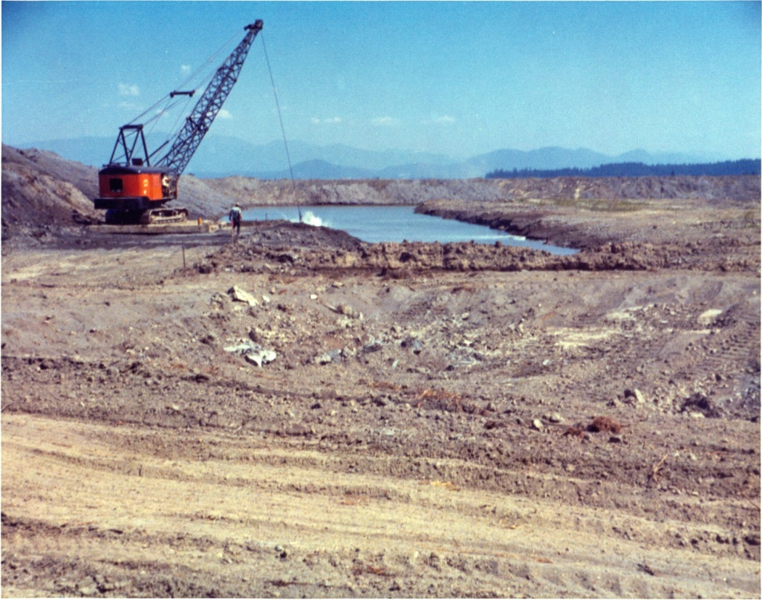
1970 First Phase Completed
The Port of Skagit completes the first phase of the La Conner Marina, a much needed small-boat harbor to serve maritime traffic through the Swinomish Channel.
To view a timeline of Port history click HERE

Slide 5
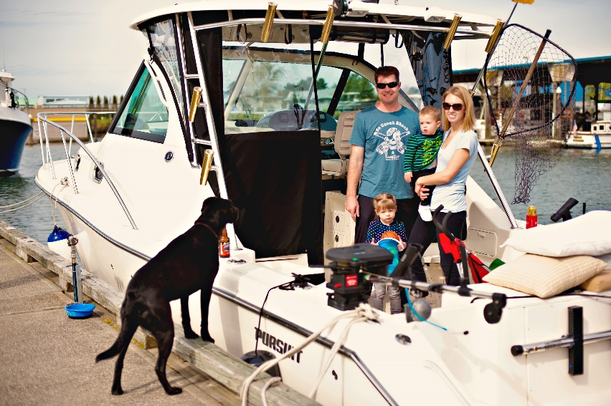
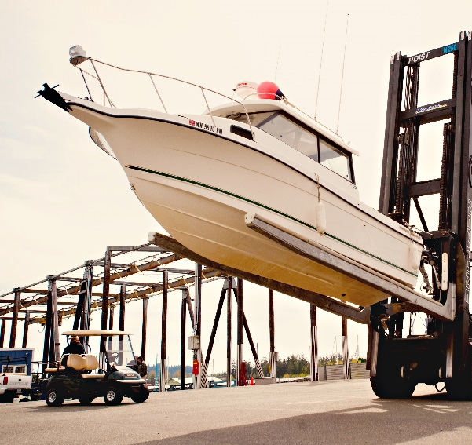
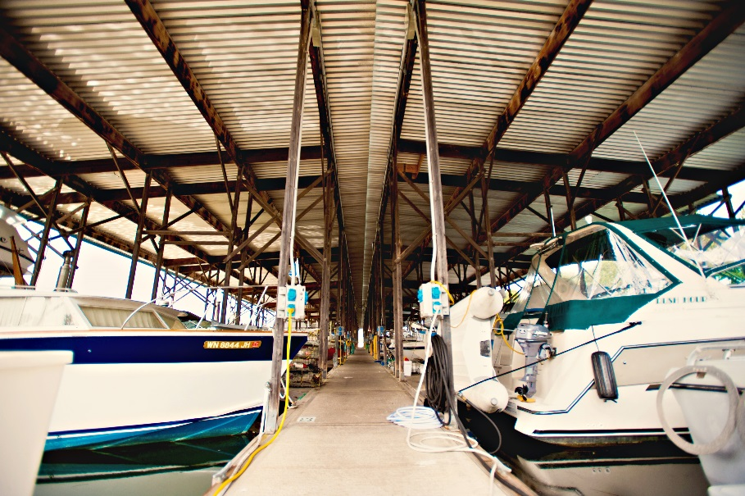
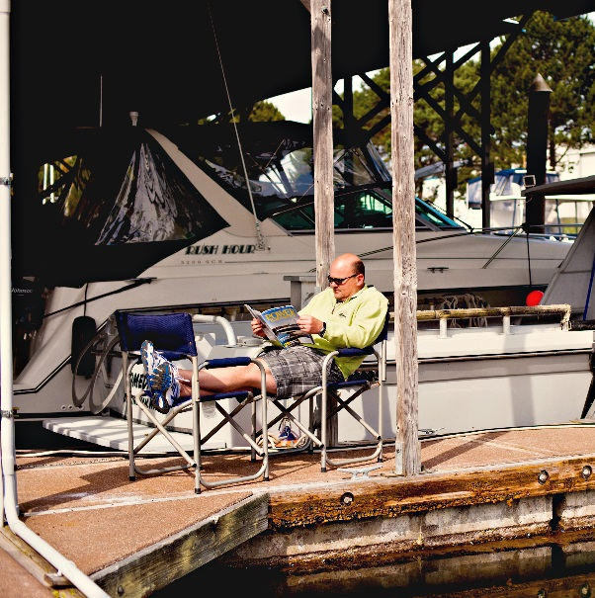
The Port’s Vision
The La Conner Marina is the premier destination in Puget Sound for recreational boaters, commercial fishers and marine-related businesses.

Slide 6
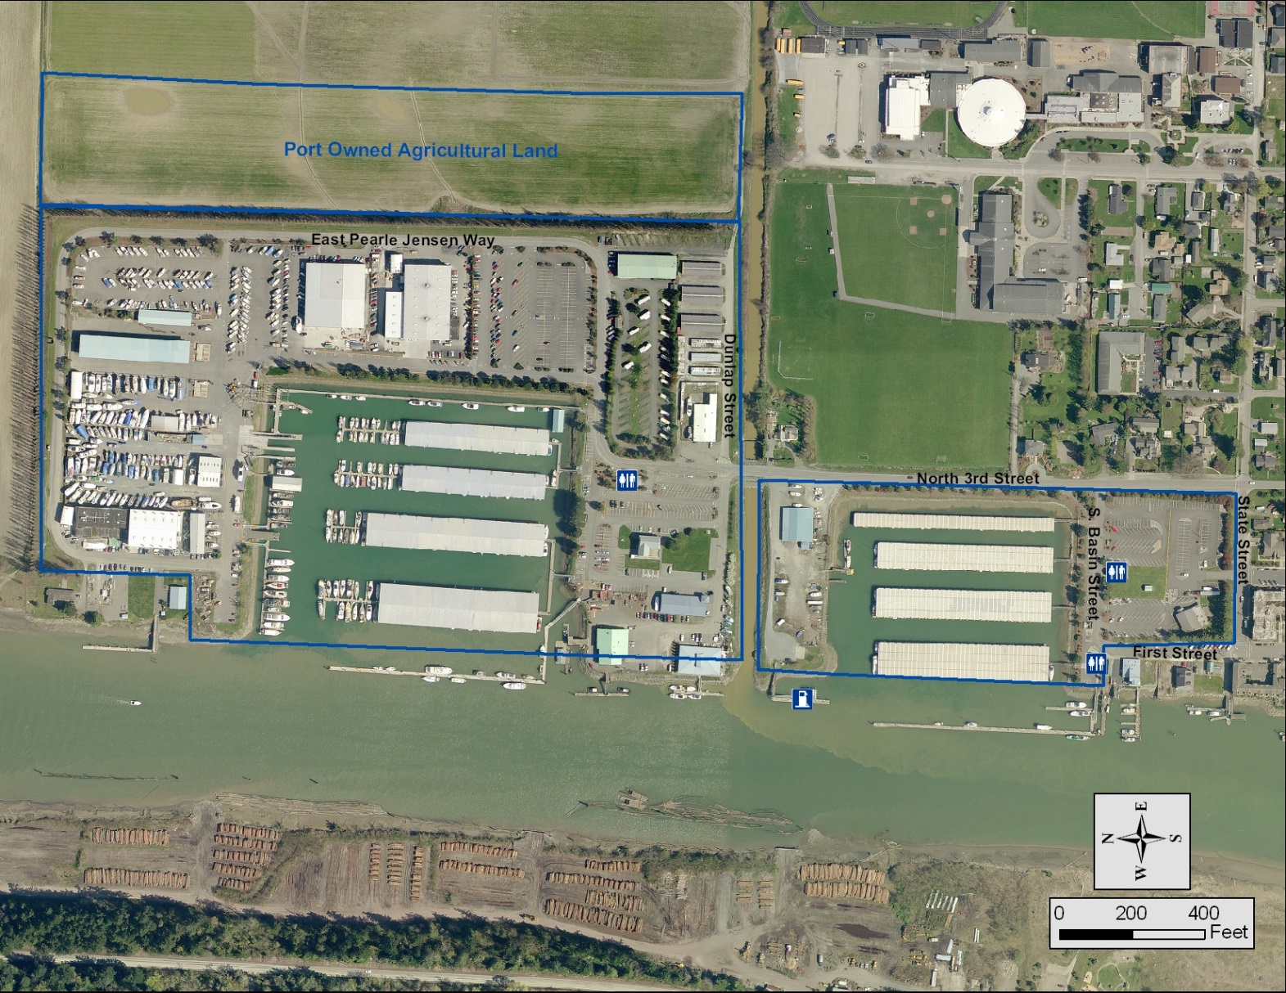
The Marina Today
Dry stack facility can accommodate up to 180 boats up to 36 feet in length
Total upland area is approximately 42 acres
For a complete list of services available click HERE

Slide 7
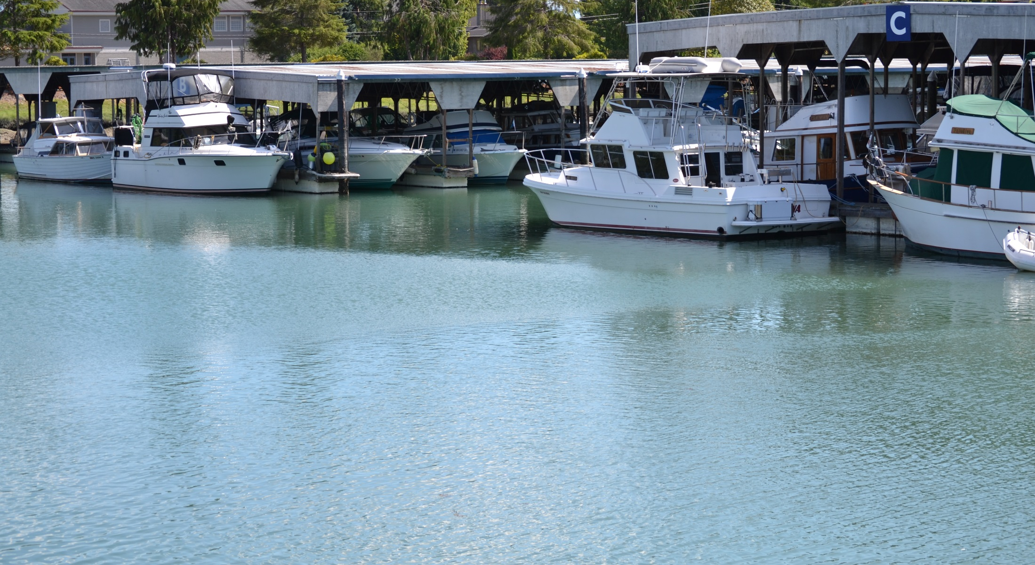
Master Plan Update
The Port of Skagit takes its stewardship of the La Conner Marina seriously. To ensure the marina continues to operate as a high-quality, useful facility for maritime purposes, the Port maintains a master plan to guide future developments.
Major goal of the master plan update is to define primary focus areas for industrial needs and recreational/tourism needs.

Slide 8
In-Water Moorage Current Slip Mix
478 slips ranging from 26 ft to 50 ft.
One major goal for float replacement is to modernize the slip mix to allow more in-water space for boats between 35 and 45 feet in length.
Percentage
Slip Size

Slide 9
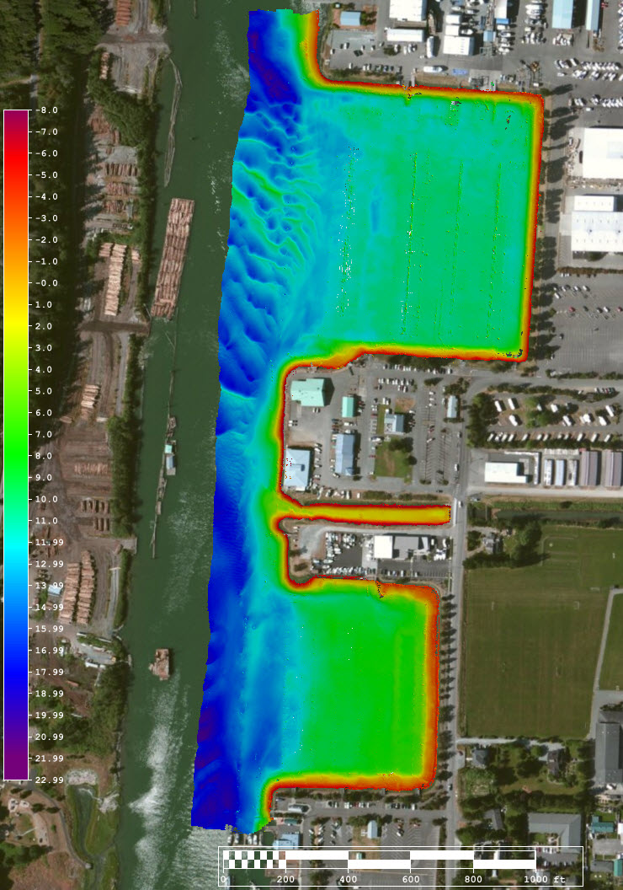
Basin Dredging
Marina Dredge – Plans to dredge the south basin in 2016.
Survey shows south basin between -12 and -5 currently. North basin dredged more recently and is scheduled for dredging in 2017.

Slide 10
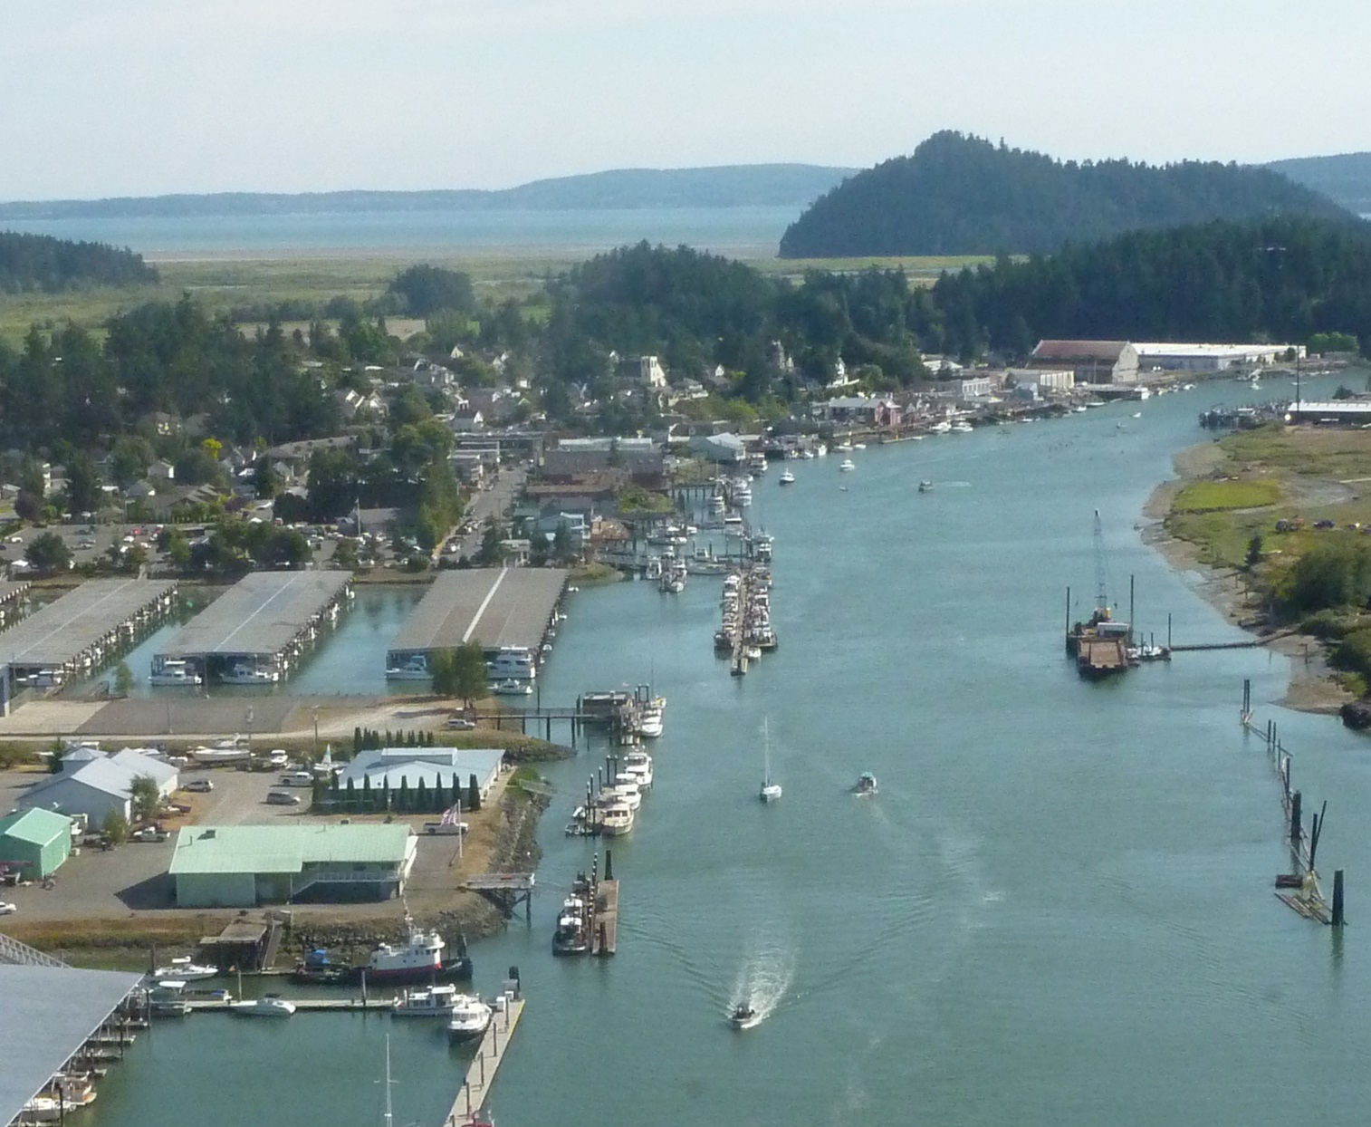
Swinomish Channel Dredging
Channel needs to be dredged every 3 years to maintain navigation depth.
Corps of Engineers completes this work with funding provided by Congress.
The Port, along with a number of partners, engages with our Congressional delegation every year to ensure this funding.

Slide 11
Capital Spending 1967 to Present

Slide 12
Capital Spending by category
18%

Slide 13
Your Voice
We want to listen to our community.
Tell us the improvements you would like to see at your La Conner Marina.
Examples of improvements are provided to the left.
Send your comments to andrew@portofskagit.com or call (360) 757-0011
Keep up on what is happening at your Port of Skagit. Like our Facebook page HERE and HERE or visit www.portofskagit.com
Complimentary services
Dry Storage Improvements
Economic Development
In-Water Moorage
Launch and Haul Out Services
Level of Services
Events
Security Upgrades
Technology Upgrades

